Slide 1
Chill'n with Windchill and other Object Associations Magic
Windchill 10.1 M040
Jay Nallani
Lead Business Analyst

Slide 2
Biography
Jay Nallani
1996 - 2009 : Dana Corporation (Pro/E User, Intralink, Design Engineer, Project Manager, System Admin)
2007 - 2009 : Ingersoll Rand PLM (Admin, Architect, Project Manager)
2010 - Present : Tyco Electronics Corporation (Intralink – PDMLink done, Enhancing PDMLink & aligning with engineering technology)
Email - Jay.Nallani@te.com
TE Connectivity - http://www.te.com/en/home.html

Slide 3
Agenda
About TE Connectivity
Windchill 10 cool stuff
Object Associations

Slide 4
A WORLD LEADER IN CONNECTIVITY
Solving connectivity challenges with the broadest range of products
Engineering driven, customer focused
Leveraging technology innovations across industries

Slide 5
GLOBAL SCALE AND STRENGTH
Transportation
Network
Industrial
Consumer
ASIA
Americas
10 design centers
38 mfg. sites
2,375 engineers
EMEA
5 design centers
33 mfg. sites
1,700 engineers
A/P (non-China)
3 design centers
12 mfg. sites
950 engineers
China
3 design centers
16 mfg. sites
1,880 engineers
$13.3B
SALES WORLDWIDE

Slide 6
7,000
LEADING WITH INNOVATION
ENGINEERS AROUND THE GLOBE
For the third consecutive year, Thomson Reuters recognized TE as a Top 100 Global Innovator. This distinction recognizes our commitment to innovation.
18,000+
PATENTS GRANTED OR PENDING
24%
2013 THOMSON REUTERS
TOP 100
OF SALES FROM NEW
PRODUCTS INTRODUCED OVER THE LAST THREE FISCALYEARS
GLOBAL INNOVATORS
$675M
MILLION INVESTED IN R&D AND ENGINEERING
IN FISCAL YEAR 2013

Slide 7
Windchill 10 Cool Stuff – Blue Line Effect

Slide 8
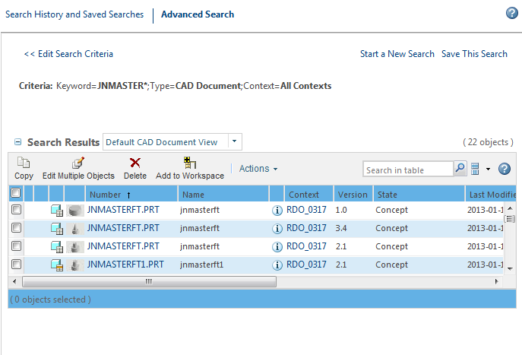
Blue Line Effect - Search Window sizing
Use these dots to size your window

Slide 9
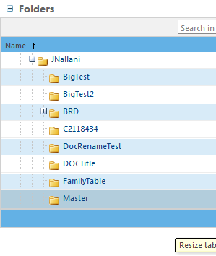
Blue Line Effect – Folder Frame sizing
Use these dots to size your window

Slide 10
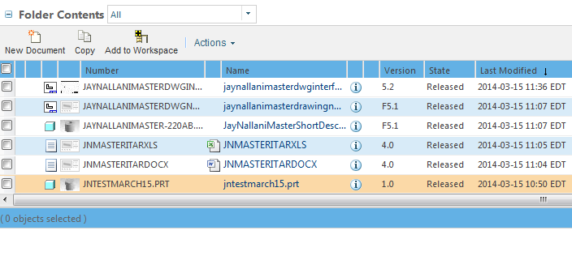
Blue Line Effect – Folder Content Frame sizing
Use these dots to size your window

Slide 11
Windchill 10 Cool Stuff – Family Table Data

Slide 12
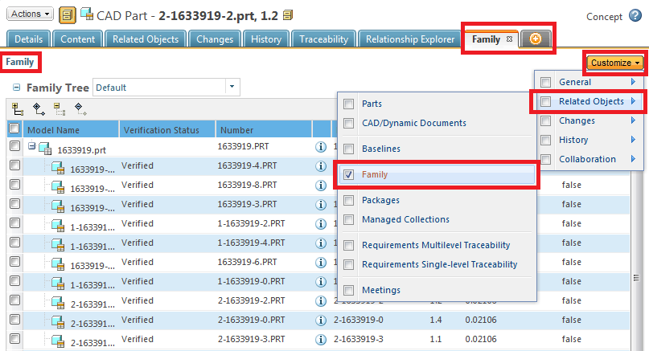
Adding Family Table info to Details Page
Add a new Tab “Family” and use customize to show related objects.

Slide 13
Windchill 10 Cool Stuff – Move a Specific version to a different folder

Slide 14
Move a Specific version to a new folder

Slide 15
Windchill 10 Cool Stuff – Set State Enhancement

Slide 16
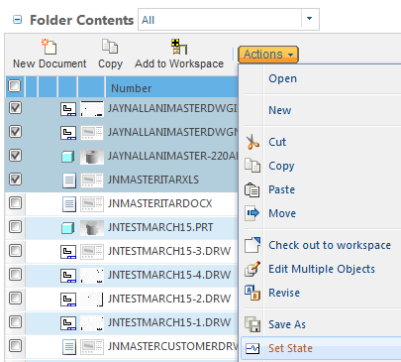
Set State Enhancement – Multiple Objects

Slide 17
Object Associations

Slide 18
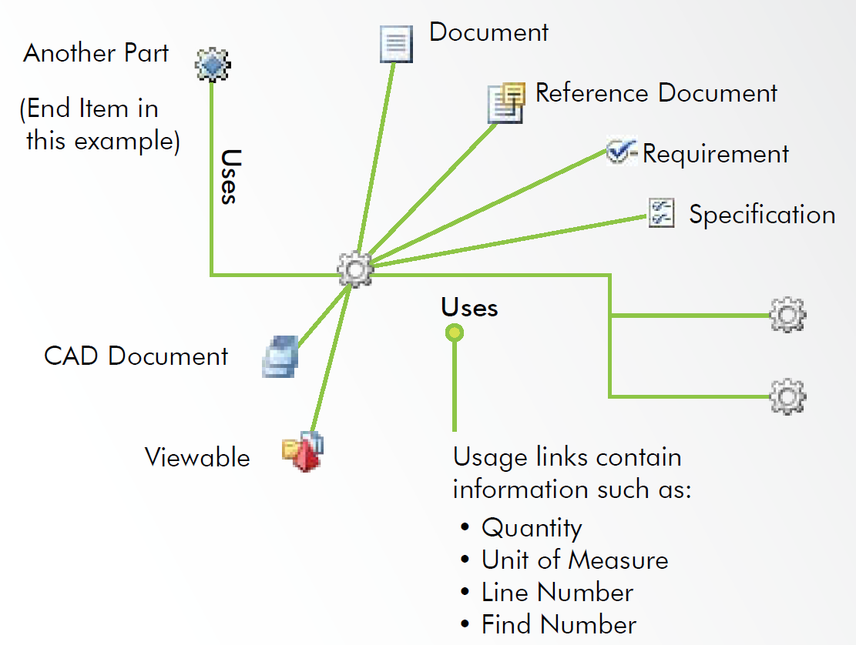
Windchill Parts - Part Relationship Diagram
Problem Statement: How/where/when … WTPart-CAD Associations work in PDMLink in Windchill 10 ?
Upcoming Session – Share with your team
PTC Live 2014 Boston
Date: Monday, June 16
Time: 05:15 PM-06:00 PM

Slide 19
How many - CAD Documents & Windchill Part Associations ?
Windchill 9.1
Windchill 10x
Active Links
(Owner)
Passive Links
(Content)
Owner
Contributing Image
Image
Contributing Content
Content

Slide 20
Where do we use Part-CAD Associations ?
Part
CAD
An Association or A Link
A Bill of Material (BOM) in general is a structured list of Parts, Sub-Assemblies and Raw Materials and related attributes such as Quantity, Revision, Unit Of Measure and Description.
Engineering BOM (EBOM) – As designed
Manufacturing BOM (MBOM) – As Built

Slide 21
Why understanding Part-CAD Document Relationship is important for EBOM ?
Windchill 9.1
Windchill 10x
Drawing
Centric
Model
Centric
Part
Centric
2D PDF
3D PDF
Model Based Definition

Slide 22
Why understanding Part-CAD Document Relationship is important for EBOM ? Cont..
Bottom-Up Design ?
Ability to Drive Part Structures from CAD Structures
Top-Down Design ?
Ability to Drive CAD Structures from Part Structures
Windchill 9.1
Windchill 10x
Only Bottom-Up Design
Both Design approaches

Slide 23
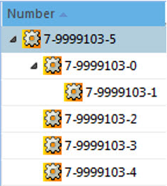
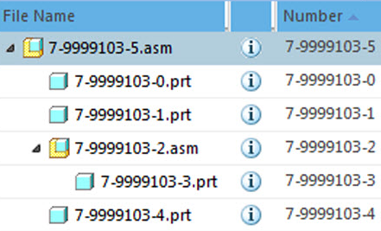
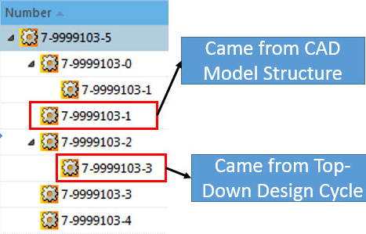
Effect of Top-Down Plus Bottom-Up Designs
Top-Down Design
Bottom-Up Design
Action Performed : Auto-Associate Check-in
Transformed

Slide 24
How the Association (EBOMs) are created?
Using Creo-Windchill Functionality

Slide 25
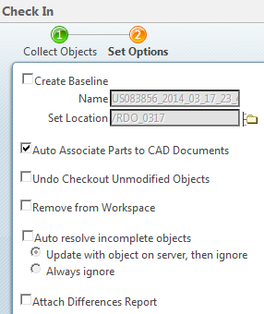
Auto-Associate during Checkin
CAD Model - Owner Association, Drawing – Calculated Association
Create CREO CAD Model and Drawing
Checkin to Windchill PDMLink
3. During Checkin, select “Auto Associate Parts to CAD Documents” to create associations.
Part
CAD
TE Standard Practice is to use Check-in with Auto-Associate

Slide 26
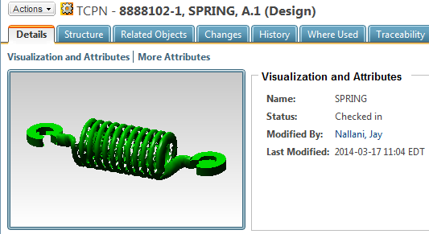
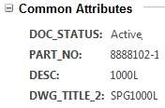
Auto-Associate during Checkin
CAD Model – Owner Association, Drawing – Calculated Association
The Thumbnail
The Attributes
The Structure
The Related Objects Association

Slide 27
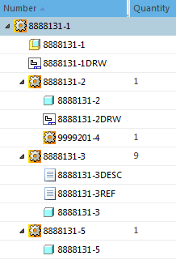
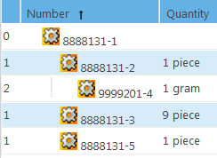
An Assembly Use Case of Auto-Associate Checkin
Product Structure Vs EBOM
Top Level Part representing a CAD Assembly Model & Drawing.
Product Structure
A Component Level Part representing a CAD Model & Drawing
EBOM
A Bulk Item Material added to the Part
A Component Level Part representing a CAD Model and two WTDocs.
A Component Level Part representing a CAD Model.

Slide 28
Life is happy, so far with Owner Links
What challenges user faces during Associations ?

Slide 29
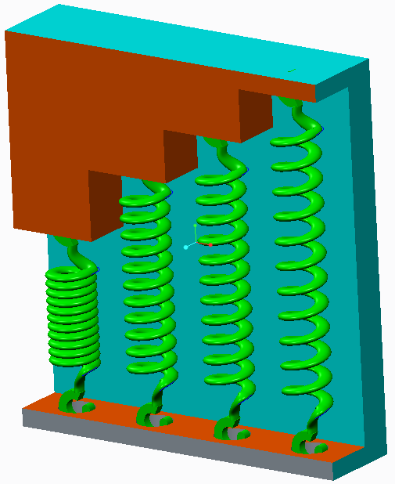
Challenges
An Assembly where same Spring to be shown with 4 different lengths.
Will the Owner Link help us with Correct Bill of Material ?
Think about this…..
Frame Assembly
Frame
4 Springs
Frame
Spring
(1000 mm)
Fully-expanded Spring
(2000 mm)
Semi-expanded Spring
(1500 mm)
Semi-expanded Spring
(1700 mm)

Slide 30
Challenges
What are some other challenges around Owner Association to get correct quantities in EBOM ?
Components that change Form/Function/Position etc.
We already talked about springs
Cables
Latches
Hinges
The list goes on …………….

Slide 31
Understanding Association Types
Part
Association
CAD Model
Association Type | Attribute | Thumbnails | Contributes to Structure | Usage
Owner |  |  |  | Associate Primary CAD document responsible for driving structure creation
Contributing Image |  |  |  | Multi-CAD secondary association, flexible components. ex. ECAD, Design Automation
Image |  |  |  | Multi-CAD secondary association, flexible components, ex. Repeating Cad in various forms/fi…..
Contributing Content |  |  |  | Multi-CAD where secondary attributes critical to BOM, IGES/STEP/Legacy CAD
Content |  |  |  | Inclusion of additional descriptive CAD content, ex. Process Plans, Layouts …

Slide 32
Exercise: How many different CAD Models can you associate to a Single Part?
Only One WTPart
Many CAD Models

Slide 33
Part to CAD Model Associations
How many different CAD Models can you associate to a Single Part?
Owner
Contributing Image
Image
Contributing Content
Content
CAD3.PRT
CAD7.PRT
CAD1.PRT
CAD2.PRT
CAD6.PRT
Max 1
Max 1
Max 1
CAD4.PRT
CAD8.PRT
CAD5.PRT
CAD9.PRT
And More …
And More …
Answer: As many as you want, rules apply.

Slide 34
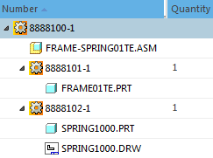
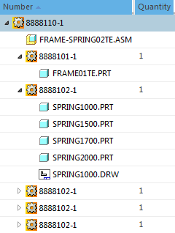
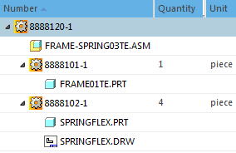
Our Previous Challenge – The Answer
An Assembly where the same Spring shown with 4 different lengths.
Will the Owner Link help us with Correct Bill of Material ?
Owner Association
Edit Association
Creo Flexible Components
Owner
Cont Image
Owner
Owner
Image
Image
Wrong Structure
Wrong Bill of Material
Messy Structure
Correct Bill of Material
Correct Structure
Correct Bill of Material
Answer: Yes, They all work at different levels.

Slide 35
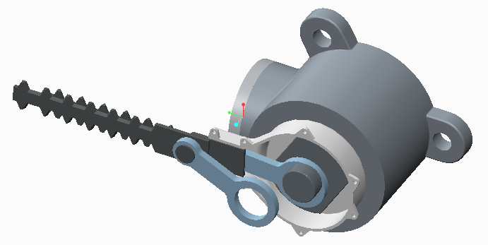
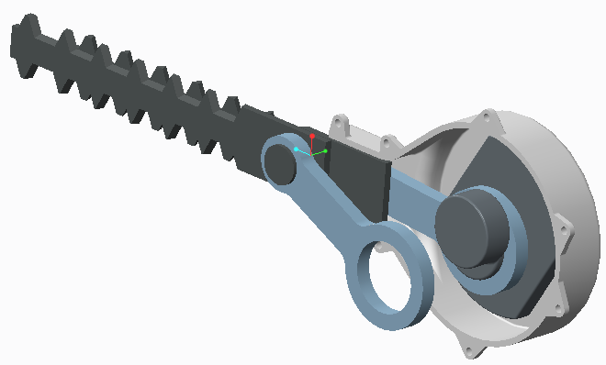
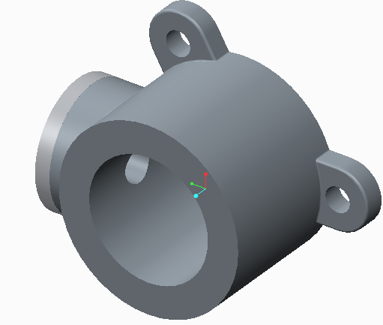
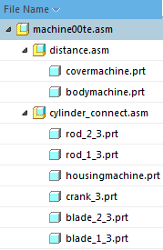
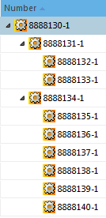
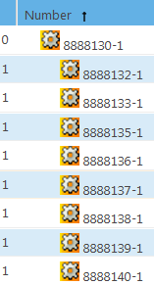
The Gathering Part attribute
A Part that is not manufactured, but has a model to facilitate the CAD design.
Gathering parts don’t appear in the Reports such as a BOM, but their children are rolled up to the next higher-level assembly in the product structure tree.
Model Structure
Product Structure
BOM Report

Slide 36
Windchill Tools available
Part to CAD Association check
Lot of good tools in Windchill 10.1

Slide 37
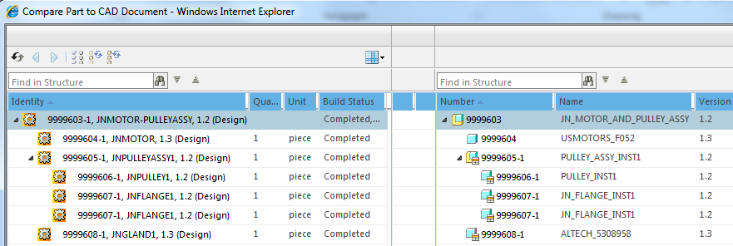
Compare Part and CAD Model Structure
Compare
Reports
Export

Slide 38
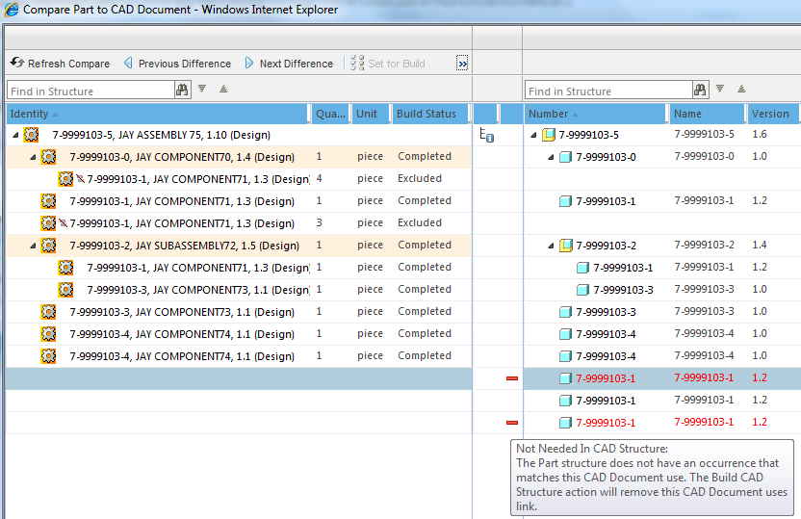
Compare Part and CAD Model Structure cont..

Slide 39
Summary - Object Associations
Windchill 10.1 M040
Part-To-Doc
EBOM
Speed to Market

Slide 40
Take away - Summary of Part-CAD Association Types
Part
Association
CAD Model
Association Type | Attribute | Thumbnails | Contributes to Structure | Usage
Owner |  |  |  | Associate Primary CAD document responsible for driving structure creation
Contributing Image |  |  |  | Multi-CAD secondary association, flexible components. ex. ECAD, Design Automation
Image |  |  |  | Multi-CAD secondary association, flexible components, ex. Repeating Cad in various forms/fi…..
Contributing Content |  |  |  | Multi-CAD where secondary attributes critical to BOM, IGES/STEP/Legacy CAD
Content |  |  |  | Inclusion of additional descriptive CAD content, ex. Process Plans, Layouts …

