Slide 1
Climbing Robot
Team SPORK, FIRST Robotics
Dave Engvall, Principal Engineer, NewellRubbermaid
11 April 2013

Slide 2
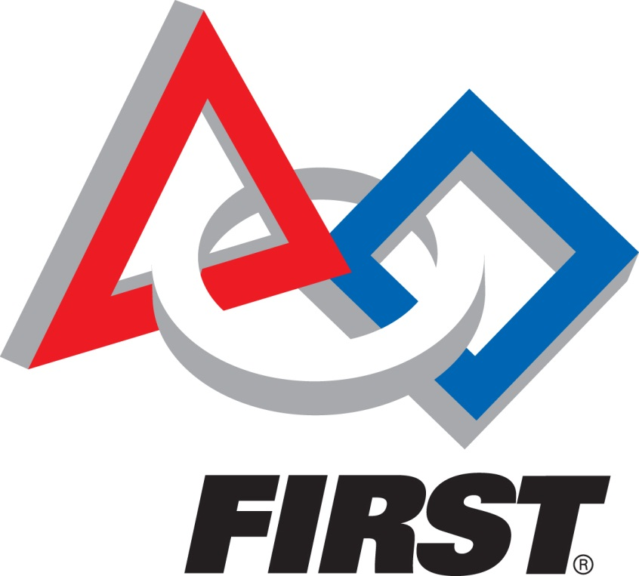
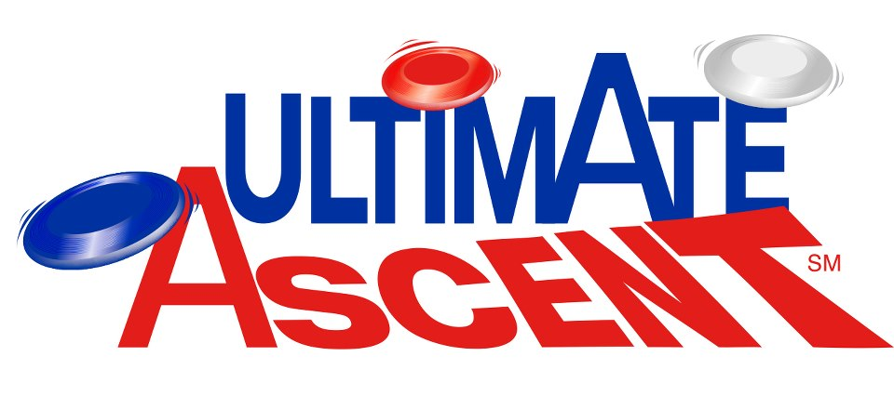
FIRST Robotics
51,000 students in grades 9-12
on 2,550 teams
http://www.usfirst.org/

Slide 3
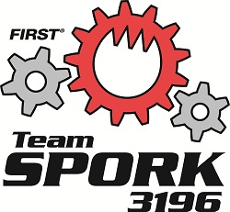
Main Sponsors
http://teamspork.com/v2/

Slide 4
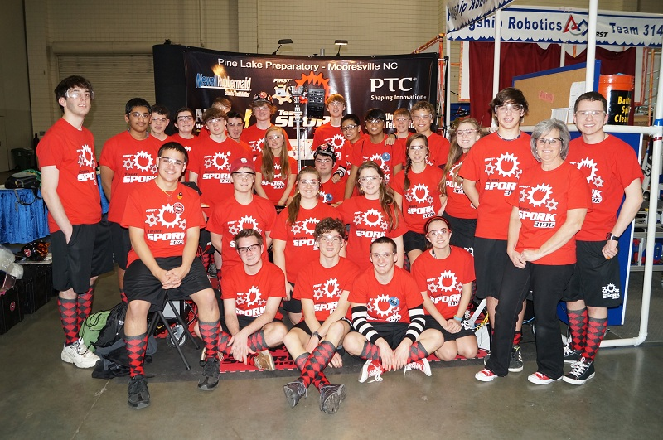
Team SPORK

Slide 5
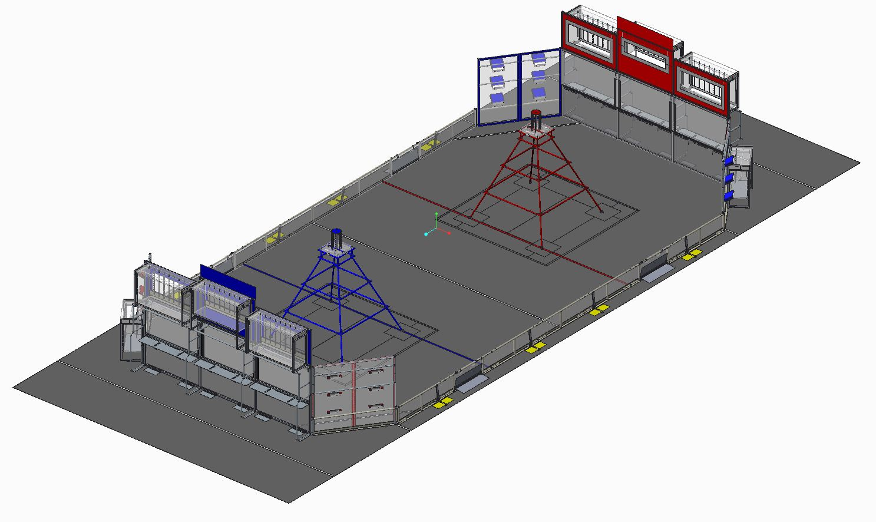
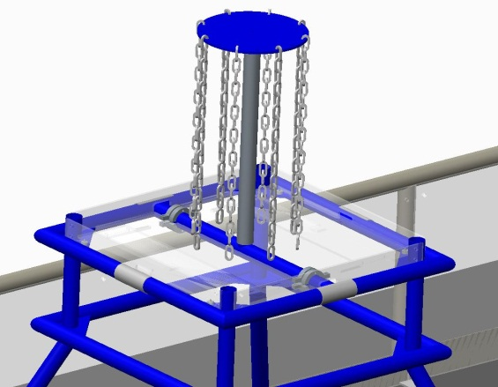
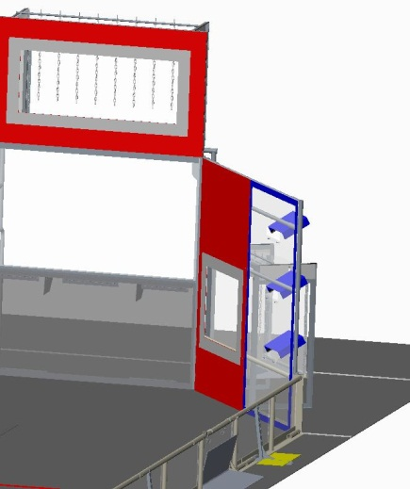
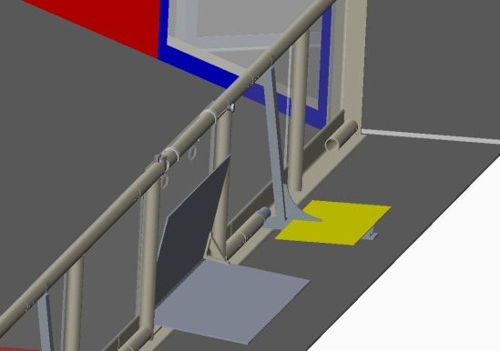
Ultimate Ascent – Field of Play

Slide 6
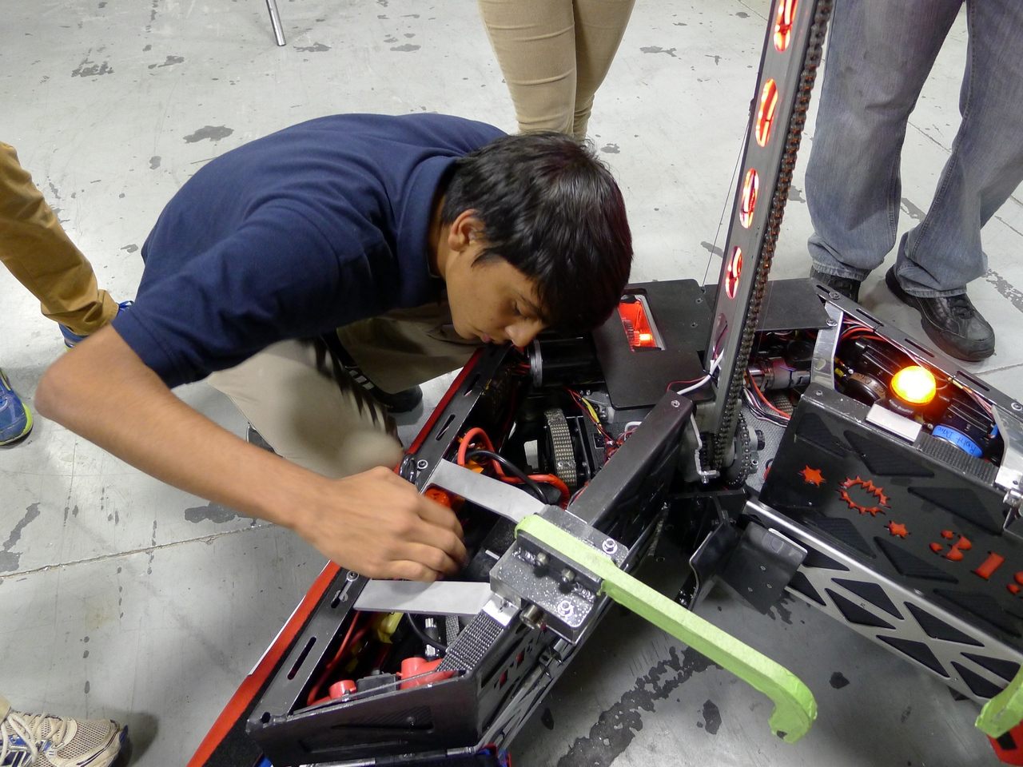
Scorpion, The Robot

Slide 7
Team Spork Climbing
Palmetto Regional, Myrtle Beach
– 65 Teams
5 Level 3’s out of 8 -- 3 other teams scored a Level 3.
North Carolina Regional, Raleigh
– 55 Teams
8 Level 3’s out of 9 -- 4 other teams scored a Level 3.
Smokey Mountain Regional, Knoxville
– 50 Teams
– 10 Level 3’s out of 11 -- One other team scored a Level 3.

Slide 8
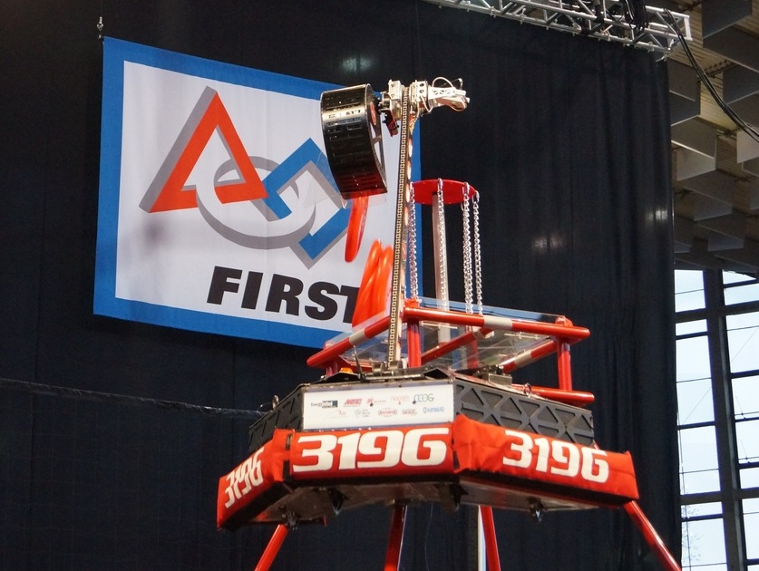
Scorpion – At The Top

